Slide 1
Statistics for linguist(ic)s
Adam J.R. Tallman
2022-11-15

Slide 2
From last class
Probability distributions
Simulating data in R
Variance
T statistic
P values

Slide 3
For this class
P values (again)
Confidence intervals
What’s a linear model
Comparing groups (ANOVA)
Bayesian vs. Traditional analyses

Slide 4
P values
A p-value is the probability of receiving a specific statistic (T statistic, F statistic, R-squared) in relation to a hypothetical sampling distribution.
You can calculate the p-value from the T/F etc. statistic.
The decision to use a given alpha level (e.g. 0.05) is arbitrary.
Often, the decision to use one statistic depends on properties of your data (are they continuous, how large is your sample size, are the groups of equal size) – sometimes its just arbitrary though.

Slide 5
P values
Type 1 error: you reject the null hypothesis when its true (false positive).
Type 2 error: you accept the null hypothesis when its false (false negative).

Slide 6
Type II Error & Power
Failing to reject the null hypothesis when its false
E.g. you get a p-value below significance level, and you think your study doesn’t support the alternative hypothesis
Power of a test: the probability of not making a Type II Error
(there’s a thing called Power analysis, which asks how larger your sample has to be to detect a particular effect)

Slide 7
Type II Error & Power
What affects Power?
Significance/alpha level (lower level = less power)
Sample size (larger sample = more power)
Sample size (larger sample = more power)
Variability (less variability = more power)
Magnitude of the effect (larger magnitude = more power)

Slide 8
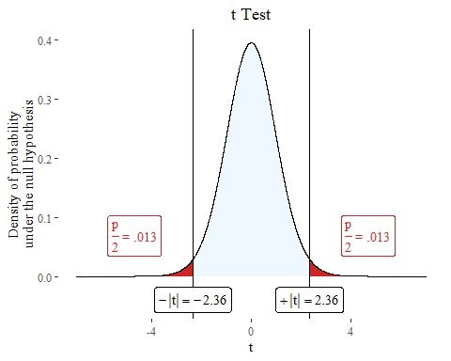
set.seed(1234) n <- 30 vowel.durations <- rnorm(n, mean = 80, sd=10) h1 <- c("strong","weak") h1 <- sample(h1, n, replace=TRUE, prob=c(0.5, 0.5)) h2 <- c("strong","weak") h2 <- sample(h2, n, replace=TRUE, prob=c(0.5, 0.5)) h3 <- c("strong","weak") h3 <- sample(h3, n, replace=TRUE, prob=c(0.5, 0.5)) h4 <- c("strong","weak") h4 <- sample(h4, n, replace=TRUE, prob=c(0.5, 0.5)) h5 <- c("strong","weak") h5 <- sample(h5, n, replace=TRUE, prob=c(0.5, 0.5)) h6 <- c("strong","weak") h6 <- sample(h6, n, replace=TRUE, prob=c(0.5, 0.5)) df <- data.frame(vowel.durations, h1,h2,h3,h4,h5,h6)
plotttest(t.test(vowel.durations~h4, data=df))

Slide 9
Type I Error & Sensitivity
Type I Error: Rejection of a true null hypothesis
Sensitivity: The probability of not making a Type I Error

Slide 10
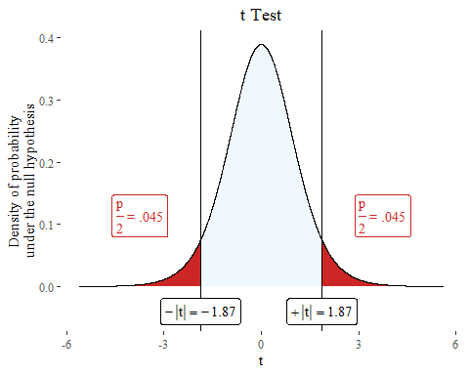
set.seed(123) n <- 6 strong.vowels <- rnorm(n, mean = 85, sd = 10) weak.vowels <- rnorm(n, mean = 80, sd = 10) strong <- rep("yes", times =n, length.out=n) weak <- rep("no", times =n, length.out=n) vowel.durations <- list.append(strong.vowels, weak.vowels) prominence <- list.append(strong, weak) t <- (mean(strong.vowels) - mean(weak.vowels)) / (sqrt((var(strong.vowels)/n) + (var(weak.vowels)/n))) t
## [1] 1.873338
plotttest(t.test(vowel.durations~prominence), tails = "one")

Slide 11
Trying and trying again or p-hacking
If we have enough variables we will eventually find a significant correlation.
If we sample more from the population we will eventually get a significant value.
If we do multiple comparisons we should adjust the p value downwards
In principle (although hard to follow in practice), use of p values should involve a stopping rule stated prior to the study, because if you gather enough data you will always eventually get a significant result.

Slide 12
Confidence interval
“A confidence interval shows the likely range in which the mean would fall if the sampling exercise were to be repeated” (Crawley 2015:61)
The interval gets wider as the unreliability goes up.

Slide 13
Confidence interval
If I say that between 35-40% of people will vote for Joe Biden in a 95% confidence interval it means
Under repeated sampling in identical conditions, the true value would be between 35-40%, 95% of the time.

Slide 14
Confidence interval
What does it mean if the confidence interval is large?
What does it mean if it straddles 0?

Slide 15
Confidence interval
What does it mean if the confidence interval is large?
There’s lots of uncertainty
What does it mean if it straddles 0?
We are not even sure of the direction of the relationship

Slide 16


Confidence intervals (for t test)
$$Lowerbound=\left(\overline{x_{1}}−\overline{x_{2}}\right)−t∗\sqrt{\frac{V_{1}+V_{2}}{n_{1}+n_{2}}}$$
Also called the Standard error
$$Upperbound=\left(\overline{x_{1}}+\overline{x_{2}}\right)+t∗\sqrt{\frac{V_{1}+V_{2}}{n_{1}+n_{2}}}$$

Slide 17
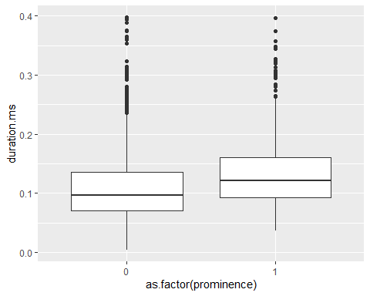
df <- read.csv("/Users/Adam/Desktop/araonavowels.csv", header=T) df <- subset(df, duration.ms <0.4) df$prominence <- ifelse(df$Stress =="y", 1,0)
boxplot <- ggplot(df, aes(as.factor(prominence), duration.ms))+ geom_boxplot() boxplot

Slide 18
ANOVA
ANOVA belongs to family of statistical techniques known as general linear models.
You are comparing the variances between two groups in relation to the variance of the groups combined.

Slide 19
ANOVA
Simulate some values according to a linear relationship / model.
set.seed(1) school <- sample(c("good", "bad"), size=30, replace=30) school.binary <- ifelse(school == "good", 1, 0) class.grade <- as.integer(rtruncnorm(a=0, b=100, m = 40, sd=15, n =30)) intercept <- 0 b1 <- 15 b2 <- 1 error <- rnorm(m=0, sd=10, n=30) test.score <- intercept + b1*school.binary +b2*class.grade + error test.score <- ifelse(test.score < 0, 0, test.score) test.score <- ifelse(test.score> 100, 100, test.score) test.score <- as.integer(test.score) data <- data.frame(test.score, school, class.grade)

Slide 20
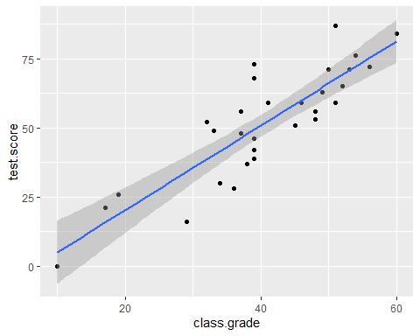
ANOVA
ggplot(data,aes(class.grade, test.score)) + geom_point()+ geom_smooth(method='lm')

Slide 21
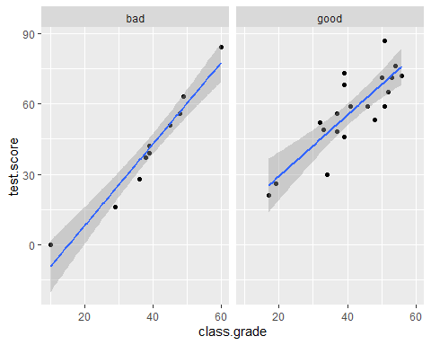
ANOVA
ggplot(data,aes(class.grade, test.score)) + geom_point()+ geom_smooth(method='lm')+ facet_wrap(~school)

Slide 22
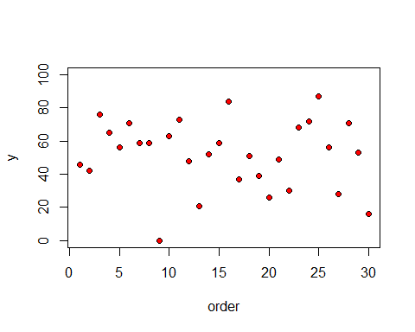
plot(1:30,test.score,ylim=c(0,100),ylab="y",xlab="order",pch=21,bg="red")

Slide 23
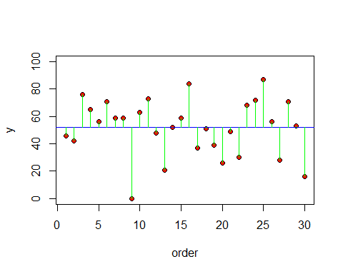

plot(1:30,test.score,ylim=c(0,100),ylab="y",xlab="order",pch=21,bg="red") abline(h=mean(test.score),col="blue") for(i in 1:100) lines(c(i,i),c(mean(test.score),test.score[i]),col="green")
$$SSY=\sum{{\left(y−\overline{y}\right)}^{2}}$$
Total sum squares = SSY
The sum of all the lengths of all the green lines.

Slide 24
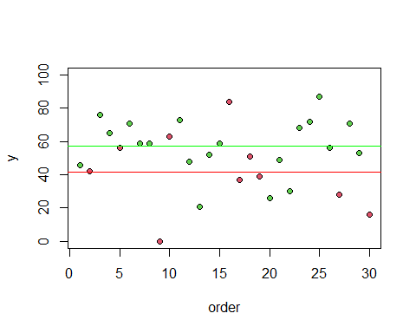
plot(1:30,test.score,ylim=c(0,100),ylab="y",xlab="order", pch=21,bg= as.numeric(as.factor(school))+1 ) abline(h=mean(test.score[school=="good"]),col="green") abline(h=mean(test.score[school=="bad"]), col="red")

Slide 25
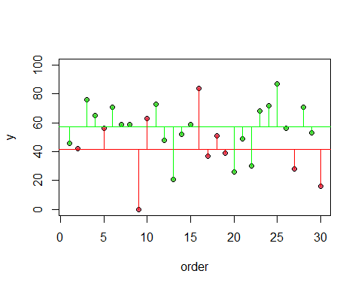

$$SSE=\sum{{\left(y−{\overline{y}}_{1}\right)}^{2}}+\sum{{\left(y−{\overline{y}}_{2}\right)}^{2}}$$
$$SSY=SSG+SSE$$

Slide 26
SSEgood <- sum((test.score[school=="good"]-mean(test.score[school=="good"]))^2) SSEbad <- sum((test.score[school=="bad"]-mean(test.score[school=="bad"]))^2) SSE = SSEgood + SSEbad
SSG = SSY - SSE

Slide 27
Conditional probabilities between data and hypothesis
Probability of a hypothesis given the data
P(Hypothesis|Data)
P(Data|Hypothesis)
P(D|H) is not equal to P(H|D)

Slide 28
Conditional probabilities between data and hypothesis
These are not the same.
P(H = Person is dead | D = They have been decapitated)
P(D = They have been decapitated | H = Person is dead)

Slide 29
P-values are types of conditional probabilities
P-values are conditional probabilities.
Are p-values P(D|H) or P(H|D)?
Is a p-value the probability of the data given the null hypothesis or the probability of the null hypothesis given the data?

Slide 30
P-values are conditional probabilities
P-values are a type of P(D|H)
The p-value does not tell us the probability of the null
Trying to assign probabilities to hypotheses violates (frequentist) statistics

Slide 31
Bayesians & Frequentists
The p-value and the philosophy underlying it are referred to as “Frequentist” or “Orthodox” statistics
Bayesian statistics is trying to get directly at P(H|D)
We start with a prior probability of a hypothesis and try to update it in the face of new evidence
Bayesian statistics doesn’t use p-values but uses measurements more similar to confidence intervals called (“credibility intervals”)

Slide 32
Bayesians & Frequentists
Frequentism: Statistical measures are based on “long-run expectations”
Long-run expectation -> hypothetical scenario where you could sample forever (probabilities are based on imaginary frequencies in a non-finite world)
Bayesians: Statistical measures are based on likelihood principle

Slide 33
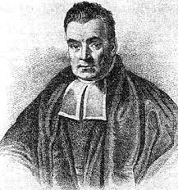

Bayes’ rule
$$p\left(H\left|D\right.\right)=\frac{p\left(D\left|H\right.\right)p\left(H\right)}{p\left(D\right)}$$

Slide 34
Bayes’ rule
likelihood
prior probability
$$p\left(H\left|D\right.\right)=\frac{p\left(D\left|H\right.\right)p\left(H\right)}{p\left(D\right)}$$
probability of observing data in general
(baseline probability or marginal probability)

Slide 35
Bayes’ rule
$$p\left(H\left|D\right.\right)=\frac{p\left(D\left|H\right.\right)p\left(H\right)}{p\left(D\right)}$$

